Slide 1

Fuel Consumption Modeling
Tanner Gorman

Slide 2



Objectives
What’s the problem?
Why is this Important?
Break down of the groups.
Exploratory Visuals.
Predict accuracy.
What this means for you.

Slide 3




What’s the problem?
With Gas Prices rising in the U.S car manufacturers are looking outside the country to understand what MPG ratings on vehicles that competitors are producing.
They are looking for new and innovative perspectives on sales as well as a forward look into the future for new designs.

Slide 4
Break down of the groups.
With data provided by Kaggle at : https://www.kaggle.com/datasets/rinichristy/2022-fuel-consumption-ratings
Dataset obtained from https://open.canada.ca/data/en/dataset/98f1a129-f628-4ce4-b24d-6f16bf24dd64 Publisher - Current Organization Name: Natural Resources Canada Licence: Open Government Licence - Canada
We are able to view all cars currently being sold in Canada in the year 2022
There are several factors that will need to be taken into account with the data provided.
I have separated key factors that would impact the informed car buyer’s decision to purchase a vehicle.
These groups are Engine Size , Cylinders, US city MPG , US Hwy MPG , CO2 Emissions, CO2 rating, Smog Rating and finally our target US Combined MPG.
I have split these groups into 2 clusters. (continued)

Slide 5
Break down of the groups. (Cont.)
Group 1 has highest in the Mean engine size which attunes well with it being highest in the Mean number of cylinders, this bodes well with it being highest in C02 emmisions, city and hwy mpg also score highest in this category.
Group 2 has very little features it is Highest in but it has our target, Combined MPG and is scoring higher in CO2 Rating as well as Smog rating it is interesting that all 3 of these colums are also my highest correlation to target.

Slide 6
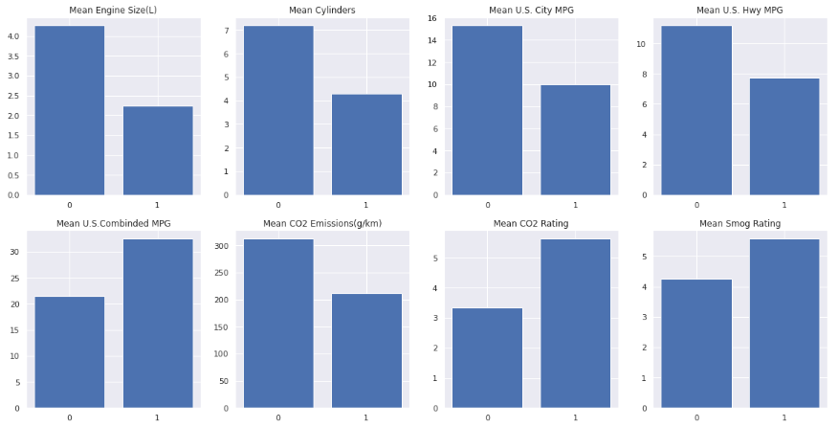
Exploratory Visuals
Each bar chart is representing a 0 or a 1 this matches the grouping I spoke of on previous slide
Together these columns will make up the features that I will use to create the predictive model.

Slide 7

Predict accuracy
I used a regression model for this exercise.
final RMSE: 0.8939898380659183
final MAE: 0.6460730838373241
Final R2: 0.9866470866171791
The R2 score shows us that our model is explaining about 98% of the variance in the target, the mean absolute error shows us that our model tends to make an error of about .7 miles per gallon, and since the root mean squared error is a bit higher than the mean absolute error, this shows us that it is possible some larger errors on some samples.

Slide 8
What this means for you
Predictive modeling can be an effective tool used take multiple factors and produce a statistical outcome for future company decisions.
With this model we were able to showcase what factors most directly impact combined miles per gallon
This can be used for decisions on building new car products
Example: If you wanted to meet an environmental goal as well as meet a particular fuel efficiency this type of modeling is capable of predicting and assisting with these decisions.
It can also be used for advertising and consumer information reports
Want to get those environment conscious yet not quite ready to make the commitment to charging their vehicle?
This modeling can supply consumers with the knowledge and peace of mind that when they purchase your vehicle that extensive analysis of environmental impact as well as fuel efficiency were taken into consideration when designing the vehicle.

Slide 9


Thank You
Tanner Gorman
Gorman72@Gmail.com

